Slide 1
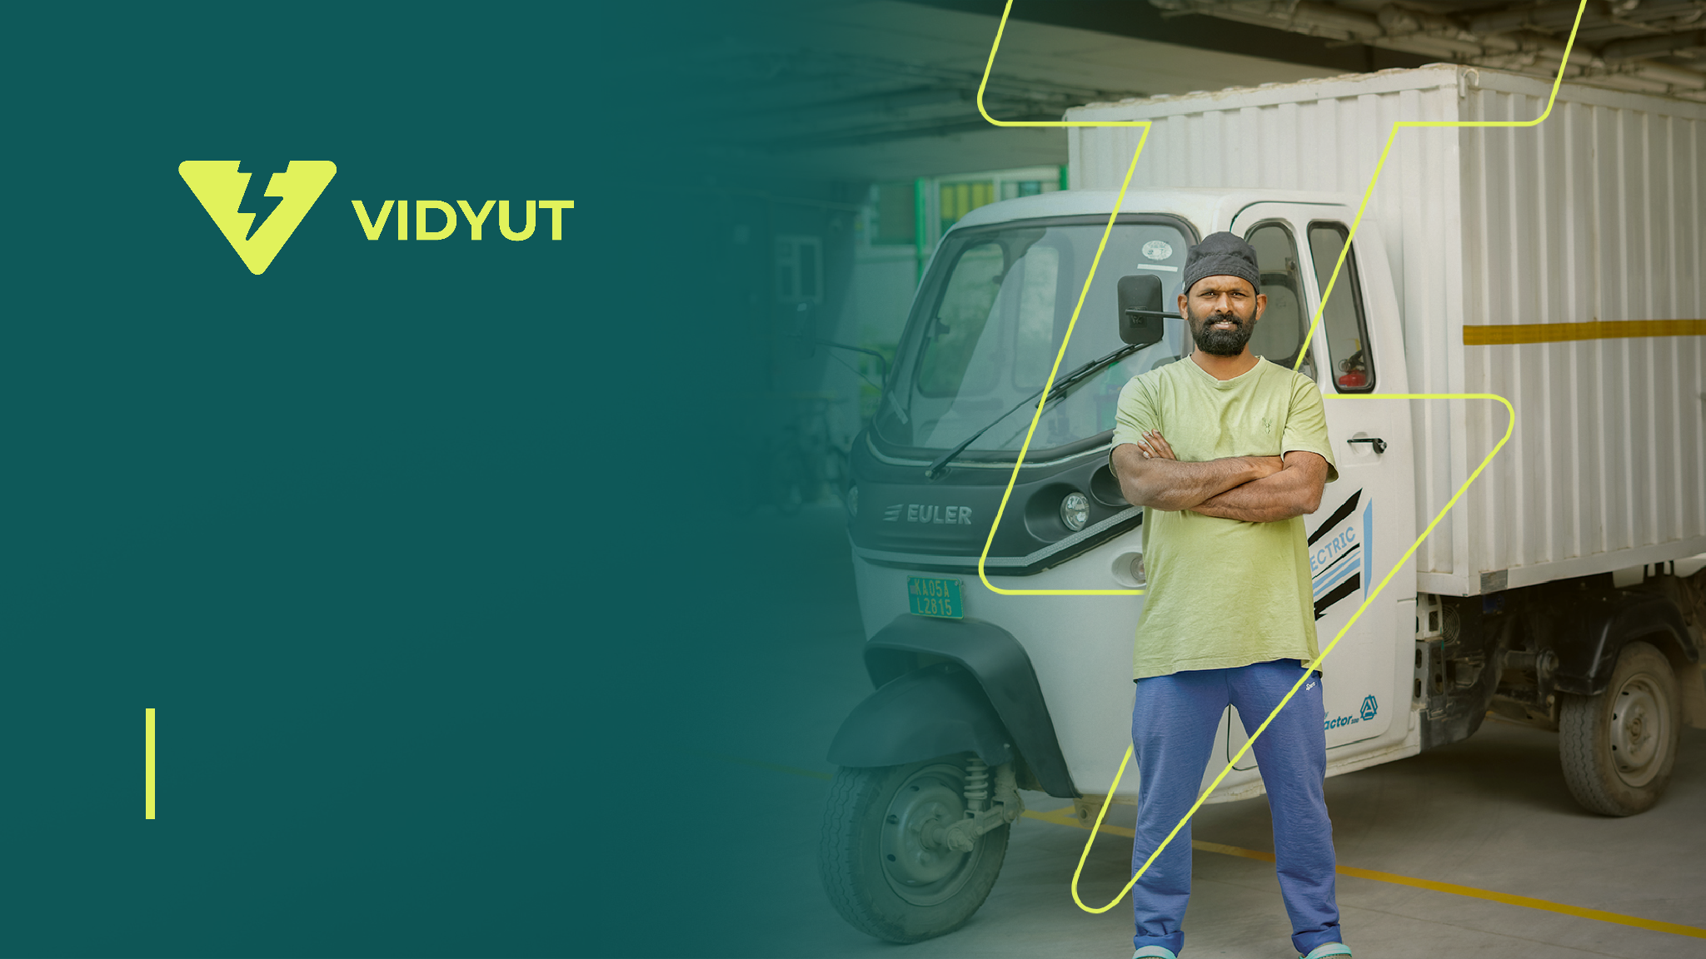

VIDYUT TECH
EV FINANCE

Slide 2
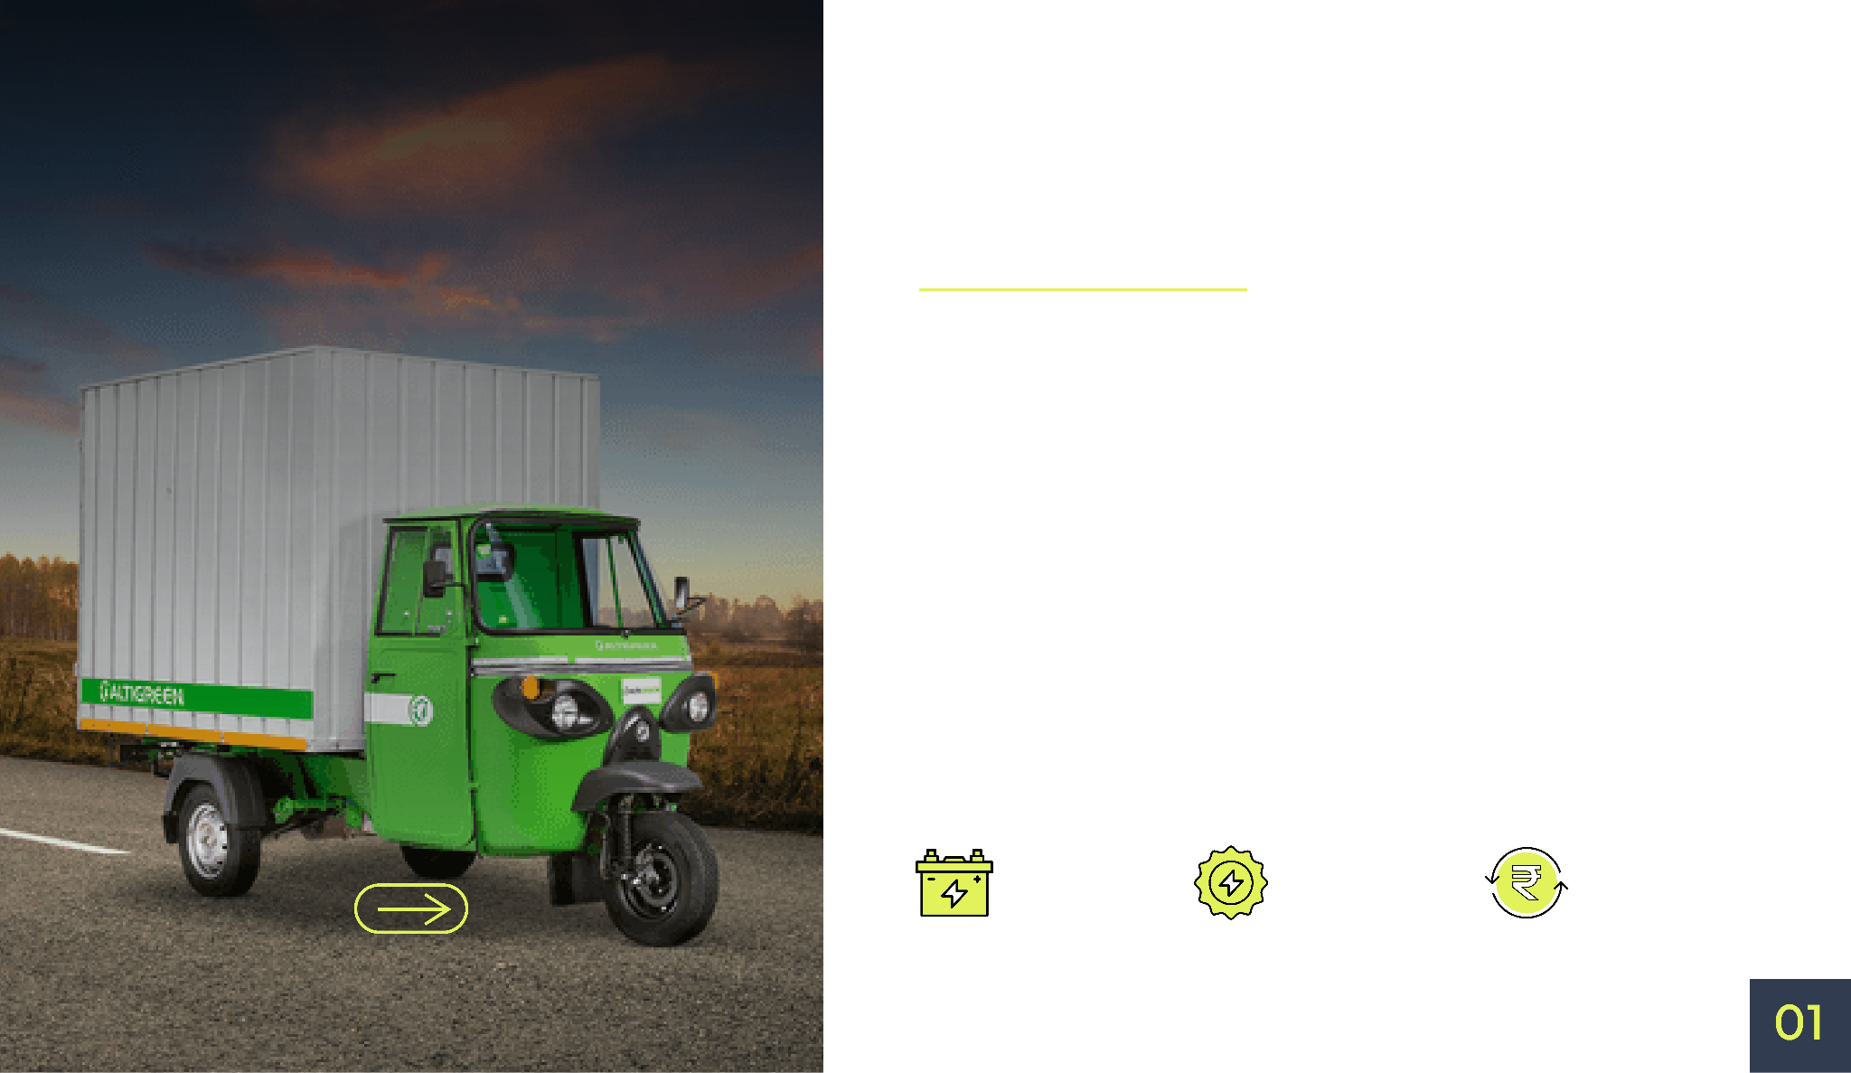

Vidyut simplifies the ownership of EVs by providing end-to-end smart financing solutions.
Know
Vidyut
Free Battery Replacement
Lifetime
Battery Warranty
Buyback Assurance

Slide 3

Vidyut Tech provides offers affordable financing and battery management solutions tailored for Indian consumers to boost EV demand in India.
India has been actively transitioning to electric vehicles, but the high cost of purchasing and the challenges of managing its lifecycle have been barriers to widespread adoption.
Vidyut Tech low-cost financing and battery subscription plans are providing stress free and risk free EV ownership.
We make total cost of EV ownership better by 35-40% right from day one.

Slide 4

A Sneak peek at
Our Journey so Far!
This idea then started operating and marked a physical presence
in Bengaluru, India in March 2022 and now Vidyut is successfully located across 20+ cities in India.
Vidyut is now present in all the major cities of India. Thus, expanding its goals and vision in a lot more places than before.

Slide 5
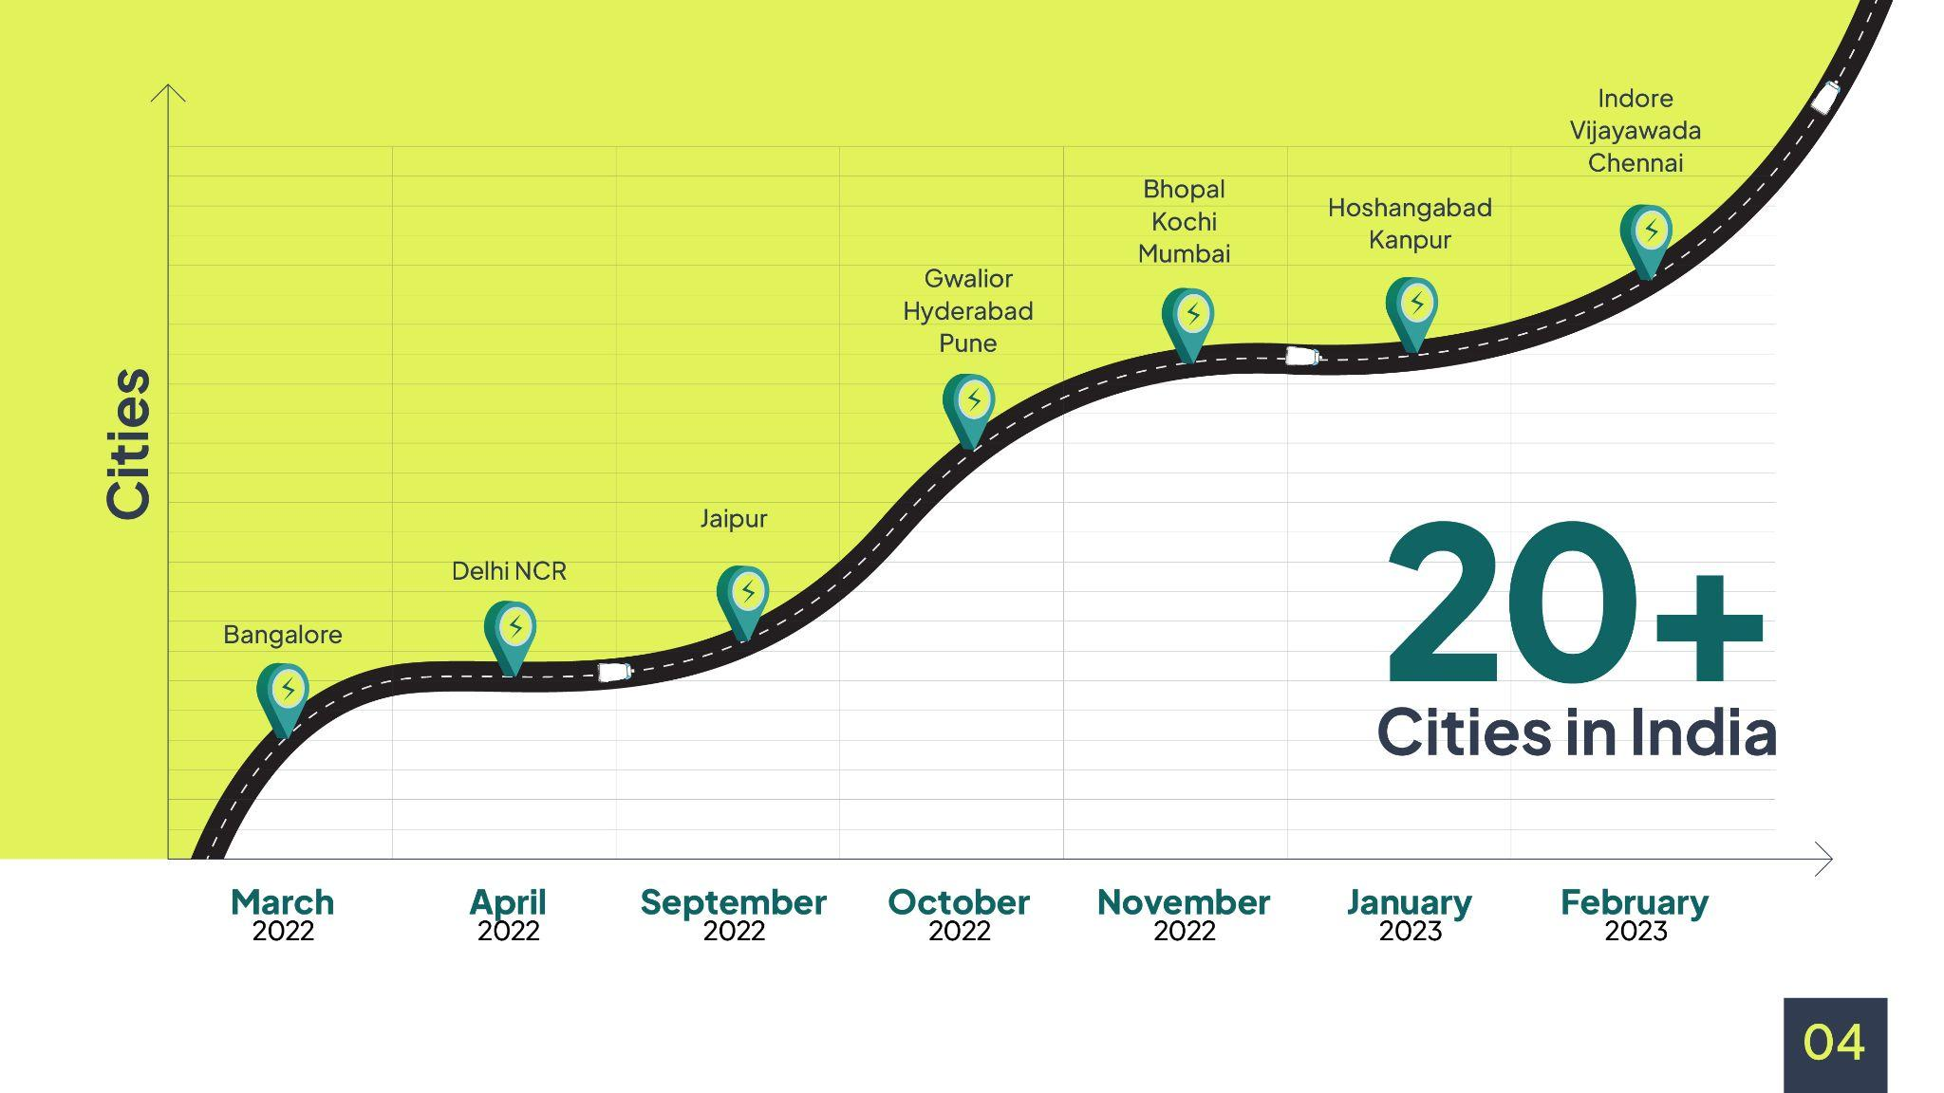

Slide 6
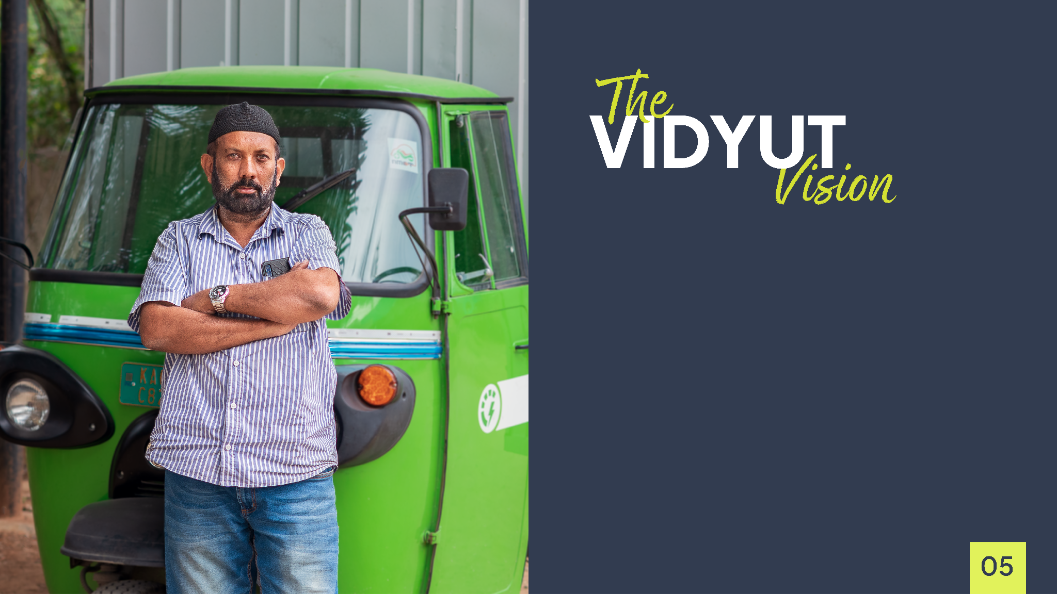
Smart financing solution for purchase - We provide innovative financing solutions that reduce down payments.
Asset lifecycle management - Battery lifecycle management is essential, and we offer a lifetime battery warranty and free battery replacement services to ensure customers get the most out of their EVs.
Resale - Resale value is a concern for EV owners, and we provide an option for customers to resell their EVs to Vidyuttech.

Slide 7

We offer unparalleled peace of mind and value for your investment in an EV compared to the traditional financing solutions.
Vidyut Tech
Other Financing
Companies
Downpayment
Tenure
Battery lifecycle
Downpayment
Tenure
Battery lifecycle
90-95%
80-85%
Upto 5 years
Upto 3 years
Lifetime battery warranty & free battery replacement
No Support
Assured buyback
Guaranteed
Assured buyback
No Support
40% Less price of the vehicle
Overall savings if you choose vidyut will be 10-20% cheaper than traditional financing companies.

Slide 8
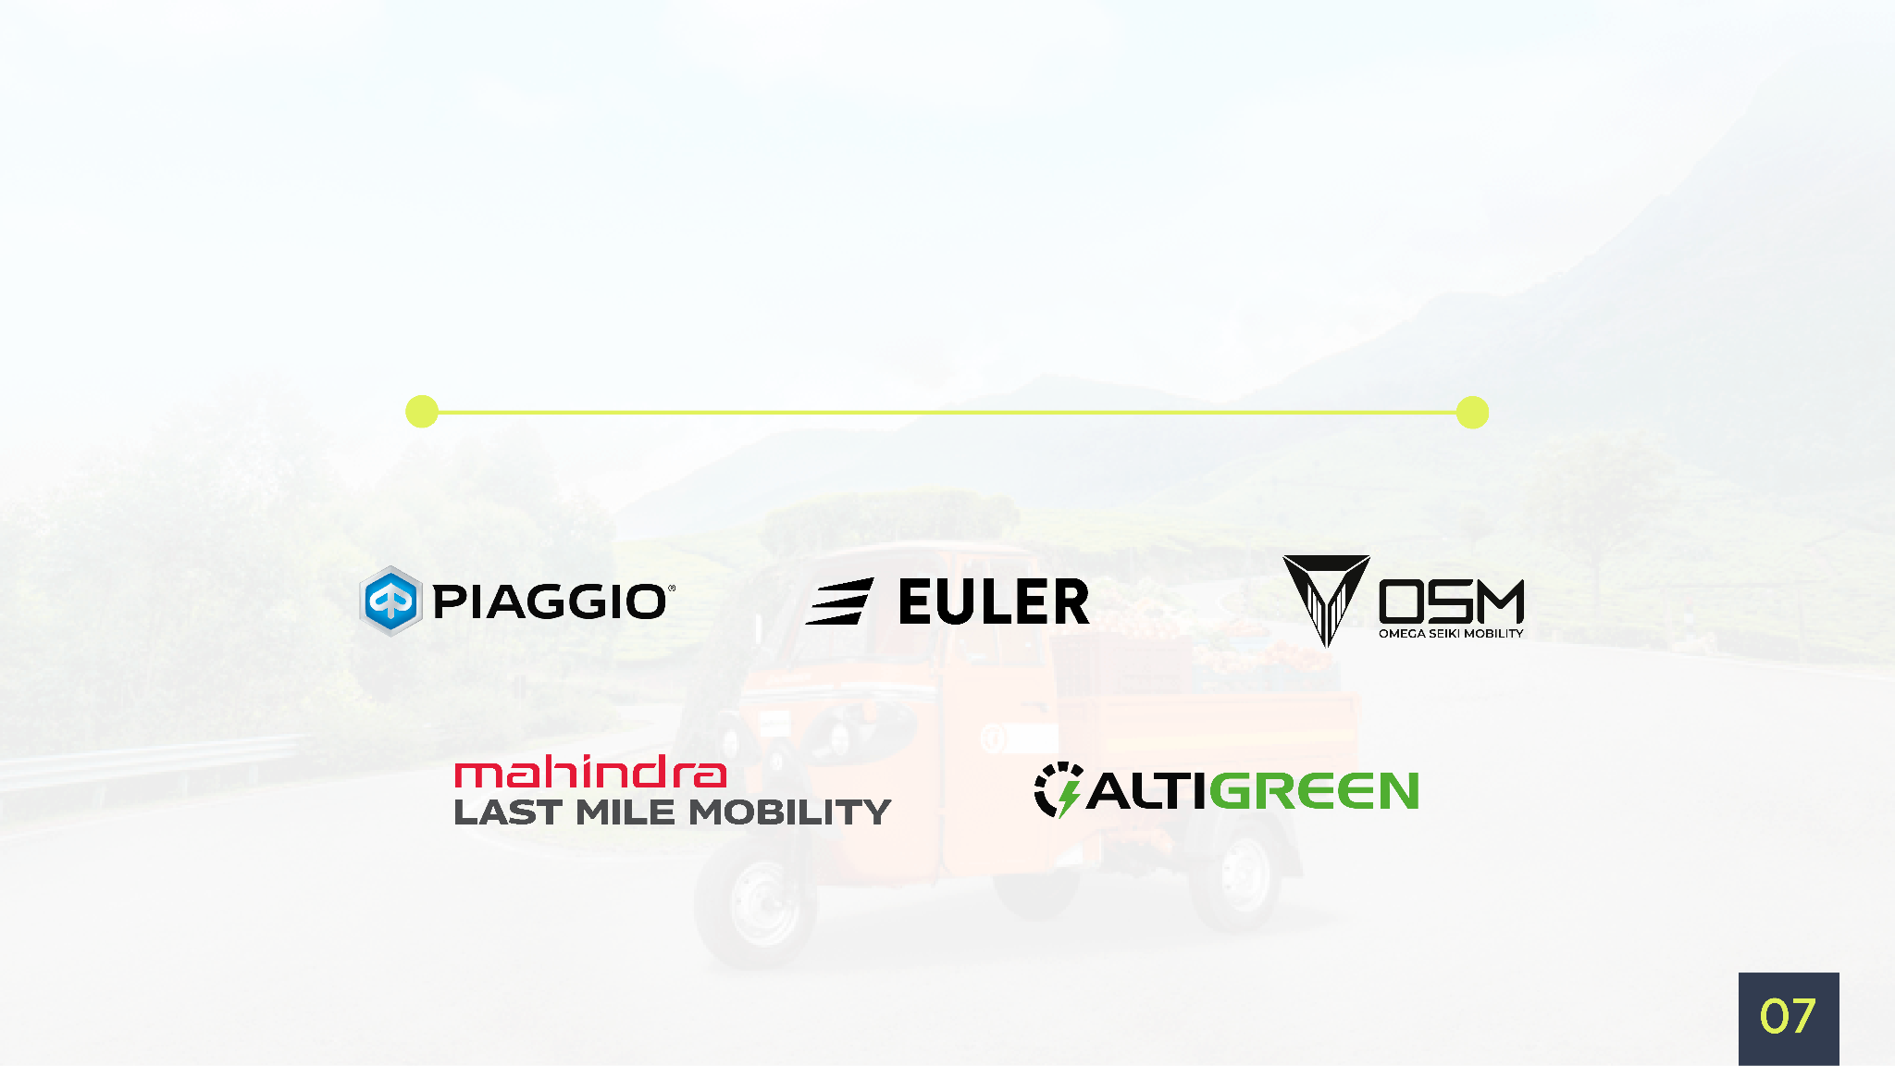
Making EV adoption easier with our Esteemed Partners

Slide 9


Vidyut Subscription
(Hybrid Financing)
Vidyuttech's battery rental plan makes owning an EV more accessible and affordable than ever before.
By owning the vehicle and renting the battery, customers can reduce their down payments and own their desired EVs more readily.
The customer buys the vehicle (Chassis and powertrain) for which vidyut provides the loan.
Vidyut Tech pays for the entire battery, which typically accounts for around 40% of the cost of an EV. This approach helps combat the high price of EVs.
Customers subscribes Vidyuttech's "Pay as you Drive" battery rental plan, paying only for what and when they drive. The rental rates are as low as Rs. 1 per km.
Vidyut Tech replaces the battery for free every 5 years or after 1-2 lakh kms for free, ensuring that customers don't have to worry about expensive battery replacement costs.

Slide 10
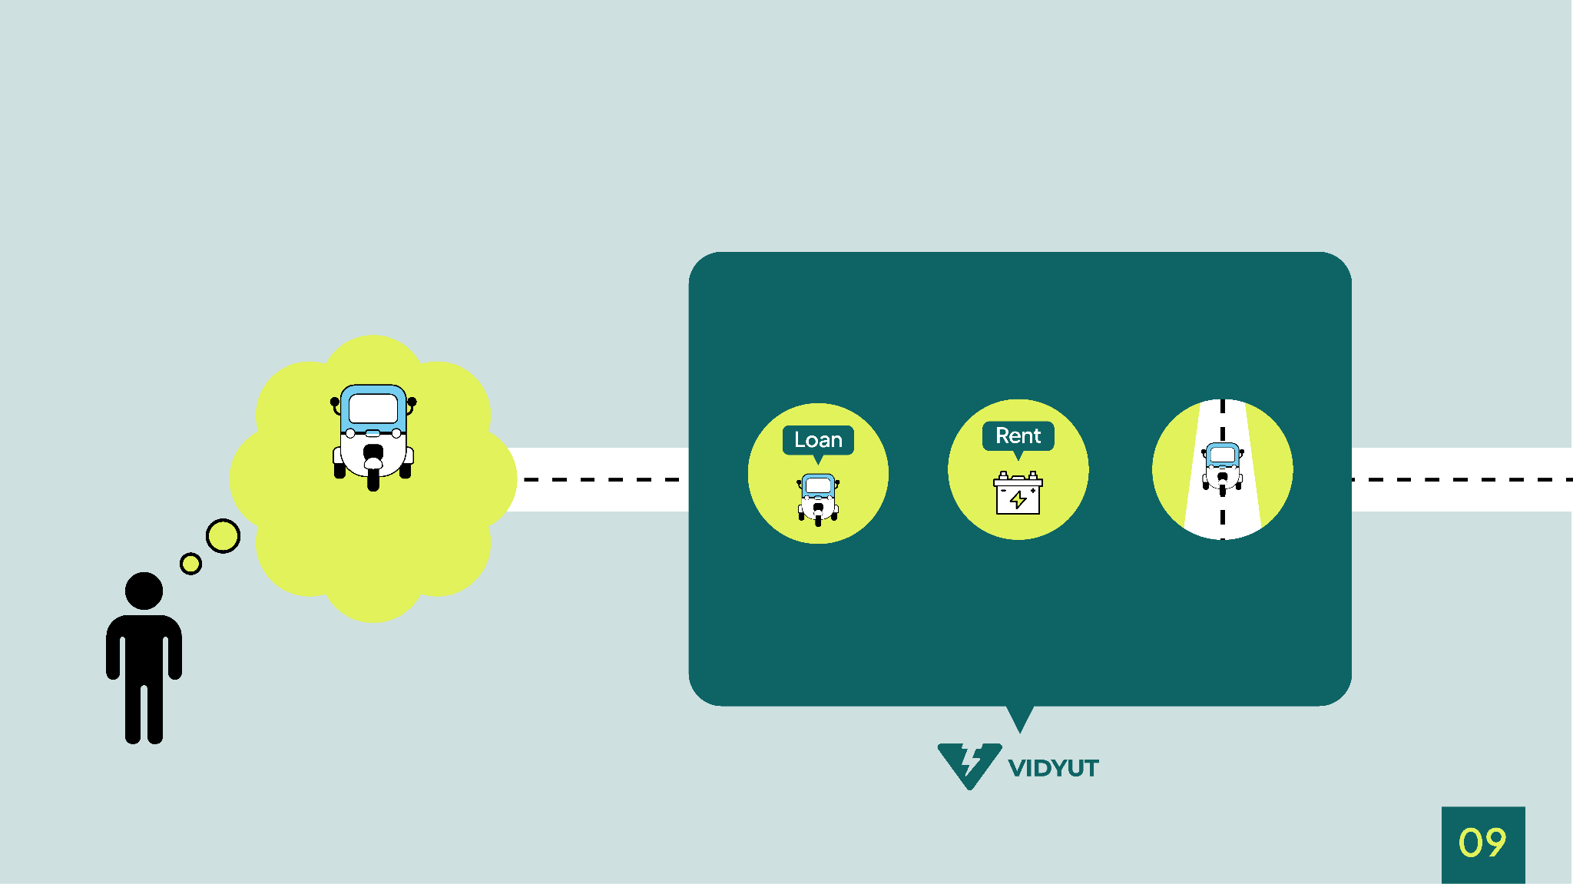
Vidyut's solutions for its heroes
Sure! We have a better solution
I need an electric vehicle but a lower purchase cost.
You take the vehicle on Loan
Rent the Battery
Pay the rent only when you drive

Slide 11
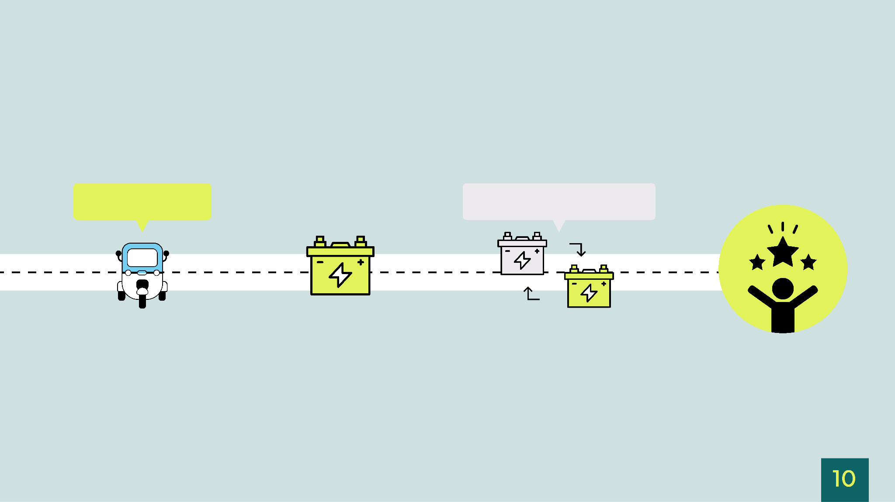
Vidyut's solutions for its heroes
Driver Subscribes to Vidyut
Replace the battery in 3-5 years for free in the same rent
Rent the battery at as low as
₹1.1 - ₹1.7 per km

Slide 12
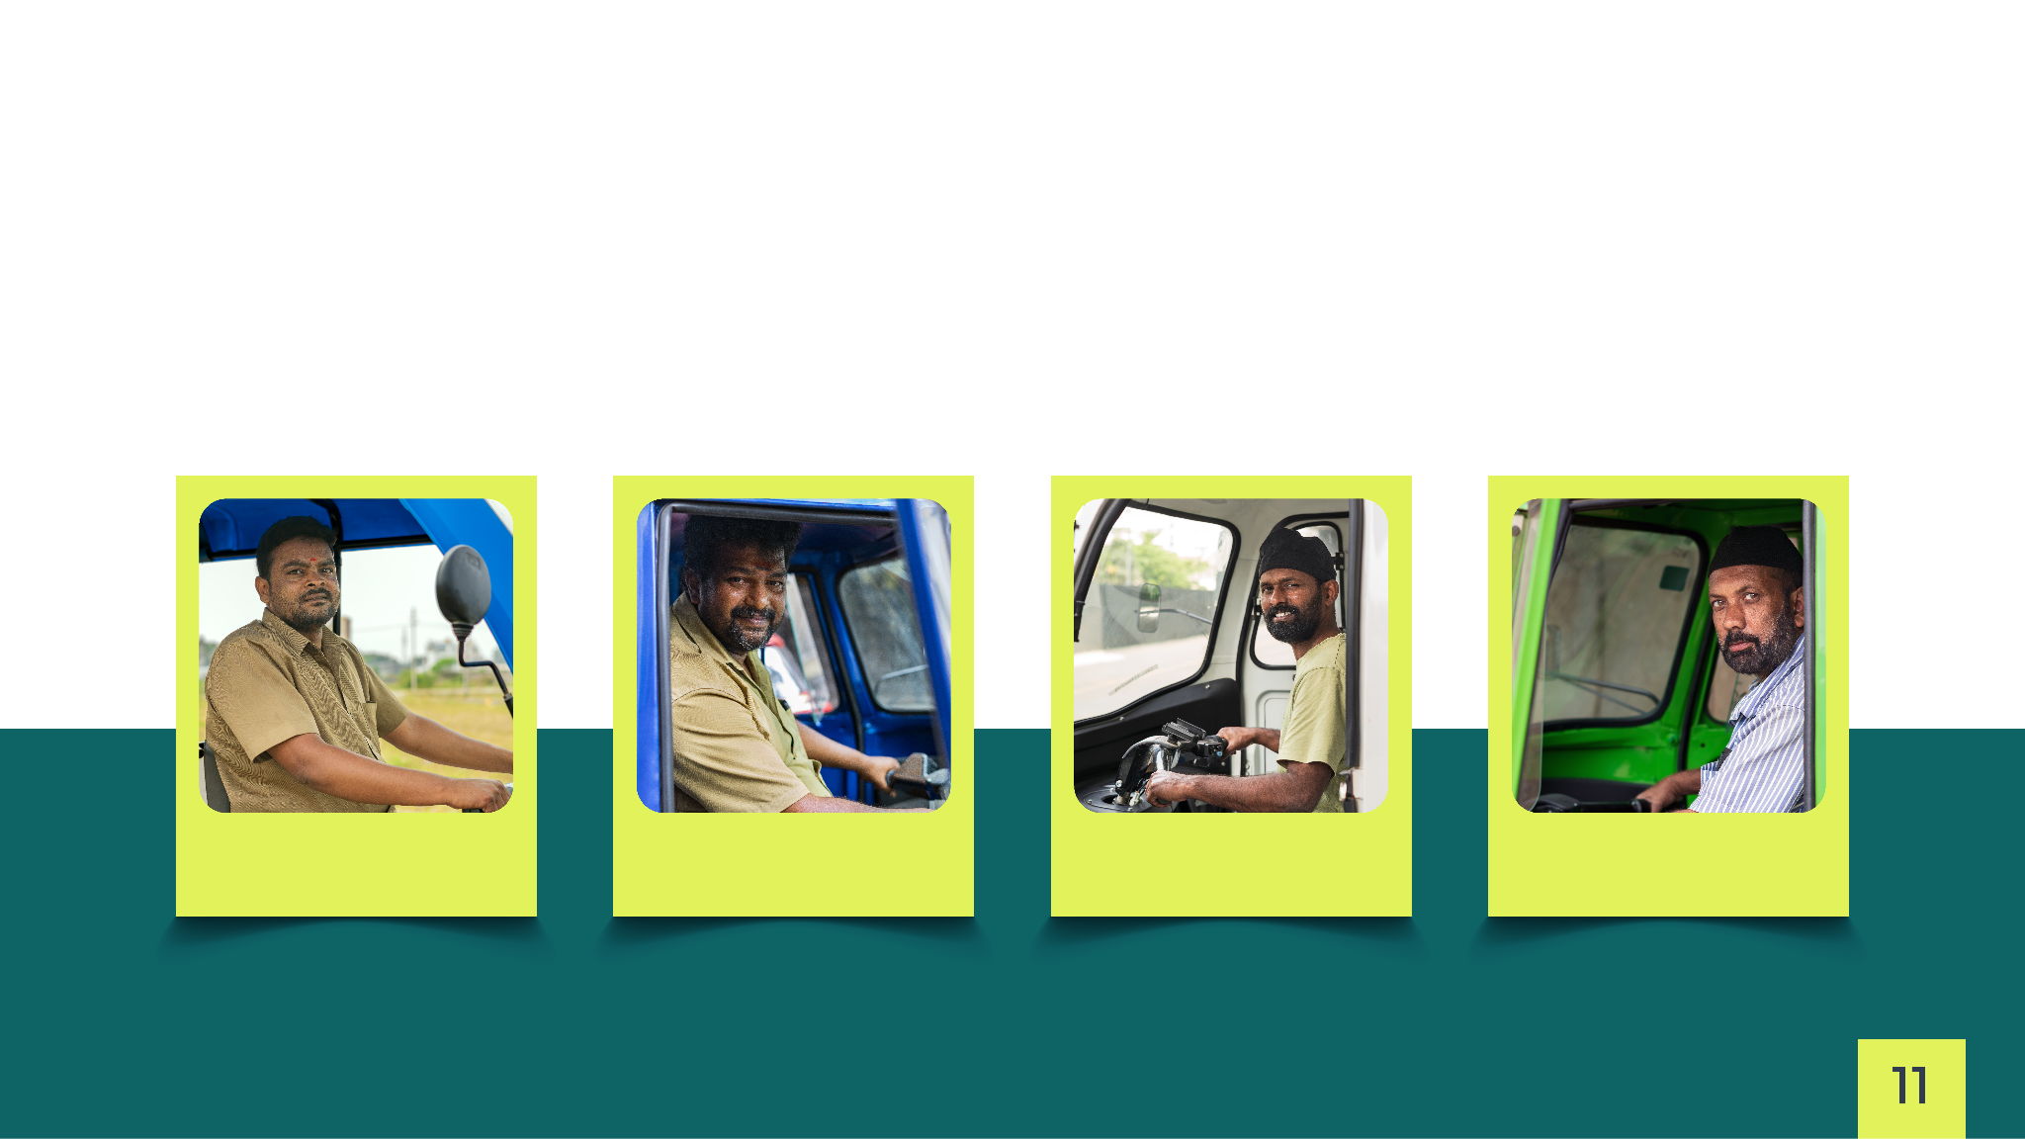
The joyful journey
of Vidyut
Nanjun Dappa, Green Drive Bengaluru, India
Mahesh, Green Drive
Bengaluru, India
Hari Krishnan, Green Drive
Bengaluru, India
Farukh Sheikh, Green Drive
Bengaluru, India

Slide 13

Vidyut Super Benefits
Give Referrals,
Earn Rewards!
Earn an EV,
Earn a job!
Enter Rewards Yug at Vidyut.
Don’t press the brakes on
Your dreams
Now you can give Vidyut referrals and earn rewards like waived-off EMI installments.
Our consumers can also get
jobs with our Logistics partners, porter and Let's transport.
Vidyut makes it Easy! Didn't we say this before?

Slide 14


